Slide 1
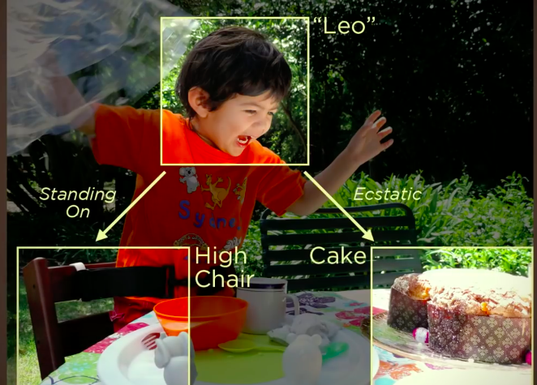
NPTEL
Video Course on Machine Learning
Professor Carl Gustaf Jansson, KTH
Week 6 Machine Learning based
on Artificial Neural Networks
Video 6.8 Convolutional Networks – Part 1

Slide 2
Structure of Lectures in week 6
L1 Fundamentals of
Neural Networks
McCulloch and Pitts
Supervised learning L2 Perceptrons Linear L6 Hebbian Learning and
- classification classification Associative Memory
- regression
L3 och L4 Feed forward multiple layer Reinforcement
networks and Backpropagation learning Unsupervised learning
L5 Recurrent Neural Sequence and L7 Hopfield Networks and
Perception Networks (RNN) temporal data Boltzman Machines
L8 Convolutional Neural
Networks (CNN)
L9 Deep Learning and
recent developments
We are here now
Development of
the ANN field
L10 Tutorial on assignments

Slide 3
Convolutional Neural Network (CNN)
A Convolutional Neural Network (CNN) is a class of ANNs.
CNN was developed primarily triggered by the challenges of image recognition.
CNN architectures are strongly influenced by our current neuro science models of the organization of human and animal visual perception.
The central convolution mechanisms of CNN are inspired by receptive fields and their direct connections to specific neuron structures.
The implementation of these mechanisms are based on the concept of convolution function in mathematics.
CNNs use relatively little pre-processing compared to other image classification algorithms. This means that the network learns the filters that in traditional algorithms were hand-engineered. This independence from prior knowledge and human effort in feature design is a major advantage.

Slide 4
Image Recognition
The classical problem in computer vision is that of determining whether or not the image data contains some specific object, feature, or activity. Different varieties of the recognition problem are:
Object recognition or object classification – one or several pre-specified or learned objects or object classes can be recognized, usually together with their 2D positions in the image or 3D poses in the scene.
Identification – an individual instance of an object is recognized. Examples include identification of a specific person's face or fingerprint, identification of handwritten digits or letters or identification of a specific object.
Detection – the image data are scanned for a specific condition. Examples include detection of possible abnormal cells or tissues in medical images or detection of a vehicle in an automatic road toll system. Detection based on relatively simple and fast computations is sometimes used for finding smaller regions of interesting image data which can be further analyzed by more computationally demanding techniques to produce a correct interpretation.

Slide 5
ImageNet
The ImageNet project is a large visual database designed for use in visual object recognition software research.
More than 14 million images have been hand-annotated by the project to indicate what objects are pictured.
ImageNet contains more than 20,000 categories with a typical category consisting of several hundred images.
Since 2010, the ImageNet project runs an annual software contest, the ImageNet Large Scale Visual Recognition Challenge (ILSVRC), where software programs compete to correctly classify and detect objects and scenes. The challenge uses a specially selected list of one thousand non-overlapping classes.

Slide 6
Image Recognition Systems
Manual Mapping
Alternative architecture
Image input in Compact Symbolic
standard pixel form characterization
of image as output
ANN architecture
CNN architecture
Automated Mapping

Slide 7
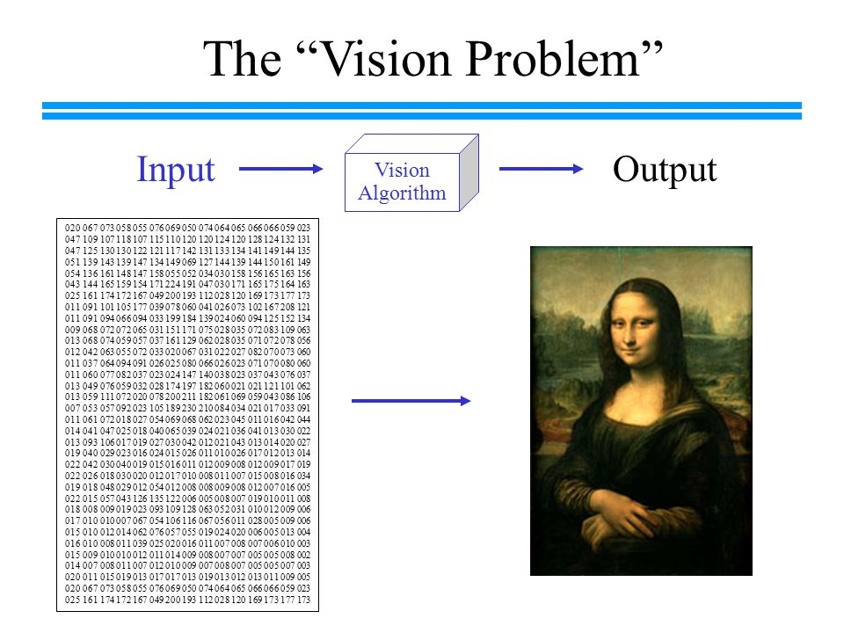
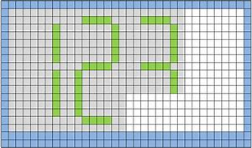
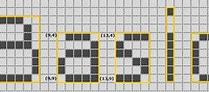
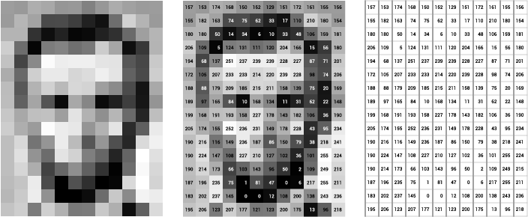
Input to Image Recognition systems - finite arrays of pixels

Slide 8
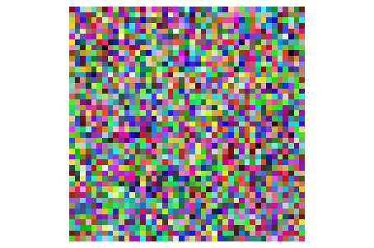
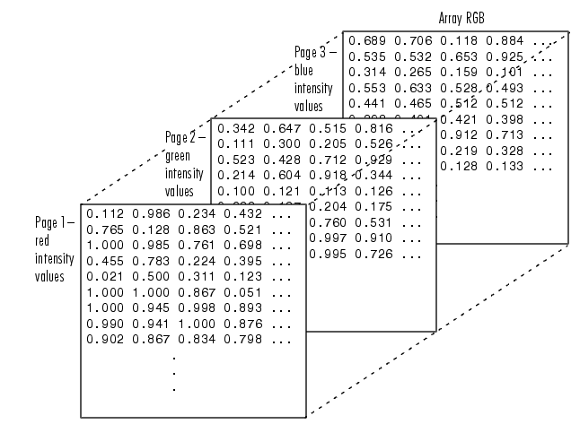
RGB Images
An RGB image, sometimes referred to as a true-color image, is a m-by-n-by-3 data array RGB ( .. , .. , ..) that defines red, green, and blue color components for each individual pixel. The color of each pixel is determined by the combination of the red, green, and blue intensities stored in each color plane at the pixel's location.
An RGB color component is a value between 0 and 1. A pixel whose color components are (0,0,0) displays as black, and a pixel whose color components are (1,1,1) displays as white.
The three color components for each pixel are stored along the third dimension of the data array.
For example, the red, green, and blue color components of the pixel (3,3,5) are stored in RGB(2,3,1), RGB(2,3,2), and RGB(3,3,3), respectively. Suppose (2,3,1) contains the value 0.5176, (2,3,2) contains 0.1608, and (2,3,3) contains 0.0627. The color for the pixel at (2,3) is 0.5176 0.1608 0.0627

Slide 9
Output from an Image Recognition system
One or several object categories (classes) present in the image
Specific objects (instances) present in the image
Subset of features of object and/or categories observable in the image
Topological and Geometrical aspects of the image
Dynamic properties of elements in the image (requires sequences of images)
All the above elements can be represented in symbolic and numeric form
A Feature vector is still a default option.

Slide 10
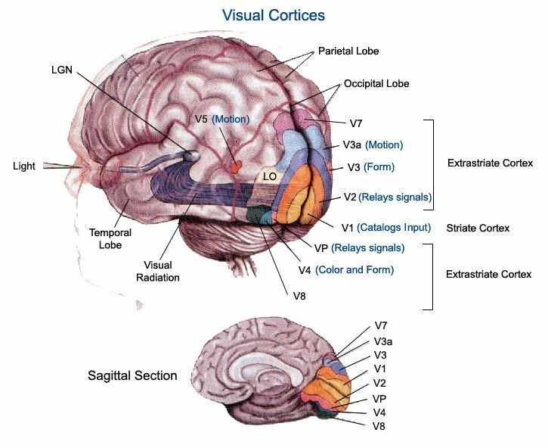
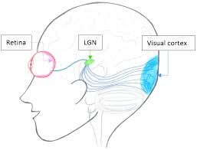
The Human Visual system

Slide 11
The Organization of the Visual Cortex
Dorsal stream
V5
Posterior
parietal Cx
Superior
colliculus
V3
V3A
STS
Eye
Dorsal
LGN
V1
V1
V2
V4
TEO
TE
Ventral stream
Striate
Cortex
Extrastriate
Cortex
Inferior Temporal
Cortex
STS Superior temporal sulcus
TEO Inferior temporal cortex
TE Inferior temporal cortex

Slide 12
The connections between Receptive fields
and Neurons in the Visual Cortex
Nobel prize awarded work by Hubel and Wiesel in the 1950s and 1960s showed that cat and monkey visual cortexes contain neurons that individually respond to small regions of the visual field.
Provided the eyes are not moving, the regions of visual space within which visual stimuli affect the firing of single neurons we call receptive fields.. Neighboring neurons have similar and overlapping receptive fields. Receptive fields sizes and locations varies systematically to form a complete map of visual space. The responses of specific to a subset of stimuli within its receptive field is called neuronal tuning.
A1968 article by Hubel and Wieser identified two basic visual cell types in the brain:
simple cells, whose output is maximized by straight edges having particular orientations within their receptive field. Neurons of this kind are located in the earlier visual areas (like V19).
complex cells, which have larger receptive fields, whose output is insensitive to the exact position of the edges in the field. In the higher visual areas, neurons have complex tuning. For example, in the inferior temporal cortex, a neuron may fire only when a certain face appears in its receptive field.
Hubel and Wiesel also proposed a cascading model of these two types of cells for use in pattern recognition task.

Slide 13
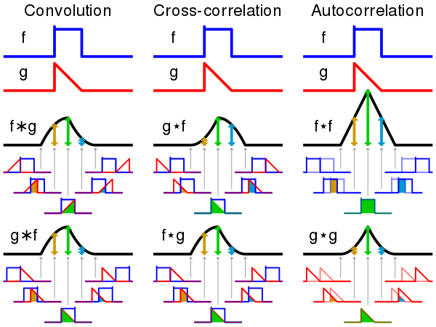
Convolution as defined in Mathematics
Convolution is a mathematical operation on two functions (f and g) to produce a third function that expresses how the shape of one is modified by the other.
Express each function in terms of a dummy variable a.
Reflect one of the functions: g(a) → g(-a)
Add a time-offset, x, which allows g to slide along the a-axis from −∞ to +∞.
Wherever the two functions intersect, find the integral of their product.
In other words, compute a sliding, weighted-sum of function f(a) where the weighting function is g(-a)
The resulting waveform is the convolution of functions f and g.
The term convolution refers to both the result function and to the process of computing it. Convolution is similar to cross-correlation and related to autocorrelation.

Slide 14
Example
Compute the convolution of f and g =f*g
f= g=
Reflect the weight
function g
Slide g
f*g = 0 f*g = 0
Result
1
1
1/2
1/2
-2
-1
1
2
-2
-1
1
2
1
1/2
-2
-1
1
2
1
1
1
1
1/2
1/2
b
1/2
¤
1/2
¤
-2
-1
1
2
-2
-1
0
x
1
2
-2
-1
X-1
1
x
2
-2
-1
1
2

Slide 15
To be continued

